Slide 1
Sex-Linkage, Punnett Squares and Pedigrees

Slide 2
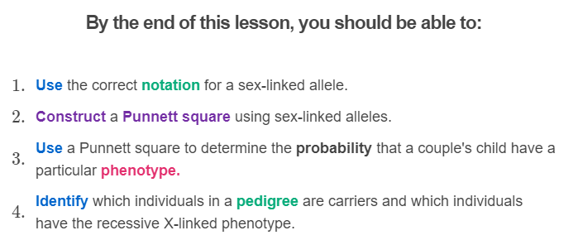
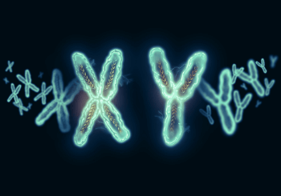

Slide 3

Some recessive sex-linked traits result in diseases.
Carriers for these diseases often want to know how likely they are to pass that disease on to their children.
We can answer this question using Punnett squares.

Slide 4
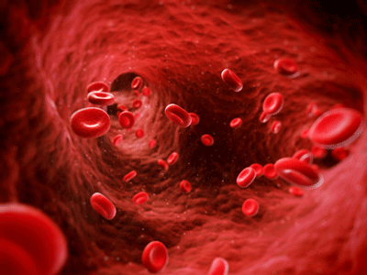
Let's look at a case study!
Kathy is a carrier for haemophilia. This is a recessive X-linked disease where the individual's blood does not clot properly. This means if they are injured and start bleeding it will be difficult to stop the blood flow. It can make everyday activities, like sport, dangerous.
As such, she and her husband Bill want to make a Punnett square so they can predict how likely their children are to inherit the disease.

Slide 5
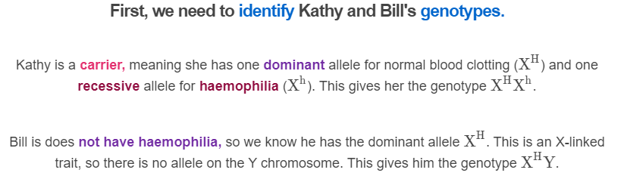


Slide 6
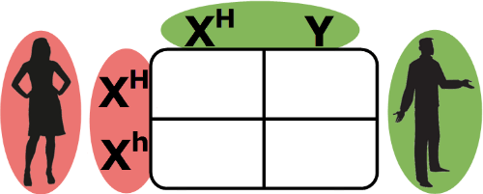
To make the Punnett square, we draw a square with four boxes inside it.
Then we add the parents' alleles. We place one parent's alleles on the top of the square and the other parent's alleles on the left. It does not matter which parent goes where.
In this example, Kathy's alleles are on the left and Bill's are on the top.

Slide 7
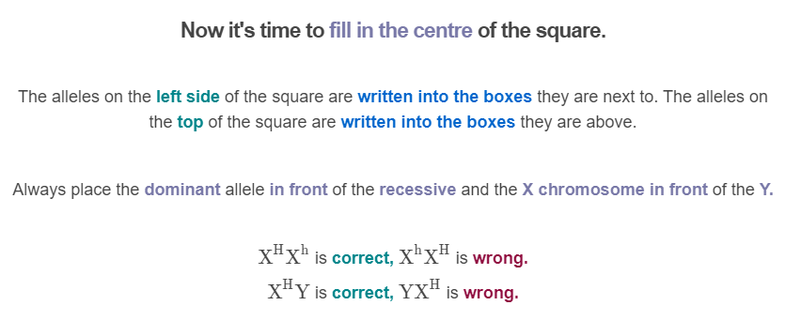
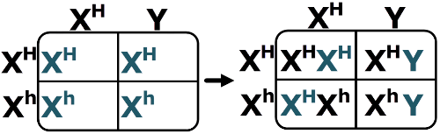

Slide 8
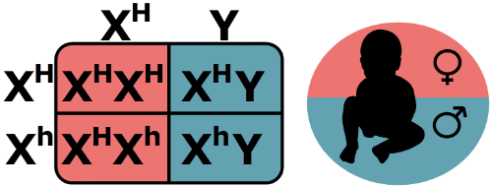
The Punnett square is now complete!
The inner four boxes represent all possible genotypes for Kathy and Bill's children.
Half of the boxes have one X and one Y chromosome. These boxes will result in male offspring. The other half have two X chromosomes. They will be female.
By looking at the alleles on the X chromosomes, we can also see that Kathy and Bill are able to produce children with haemophilia!

Slide 9
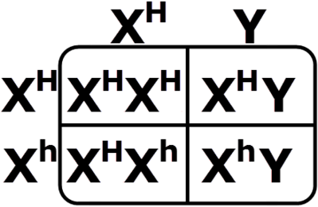
Let's practice reading these sorts of Punnett squares.
Can you work out how many of these squares show a son with haemophilia?
How many show a daughter with haemophilia? How many produce carriers?

Slide 10
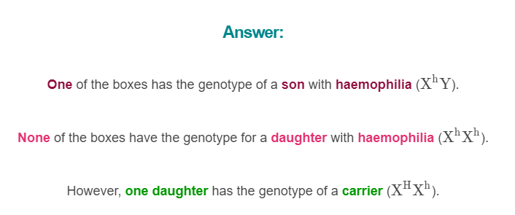
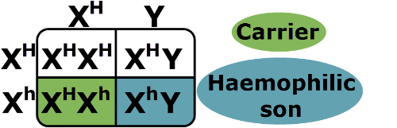

Slide 11
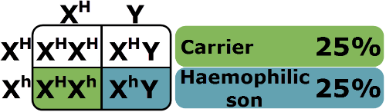
Punnett squares can also be used to calculate the chance of each offspring having a particular phenotype.
Each box in a Punnett square represents a 25%, or 1/4, probability of occuring. This means if a couple has a child, that child has a 25% chance of inheriting the genotype written in that particular box.
This Punnett square shows that each time Kathy and Bill have a child, it has a 25% chance of being a boy with haemophilia and a 25% chance of being a female carrier.

Slide 12

Sometimes families want to track the inheritance of sex-linked alleles through their family lineage.
This helps them see who is affected by a recessive sex-linked disease, who is a carrier and whether an allele was introduced or lost from one generation to the next.
Pedigrees are useful tool for tracking alleles across generations.

Slide 13
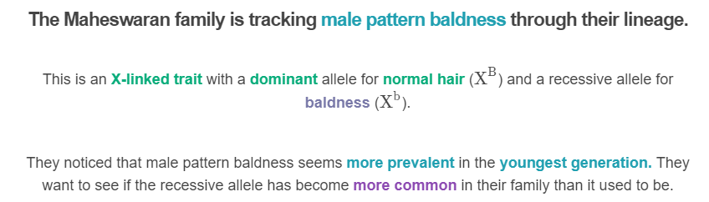
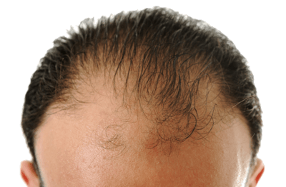

Slide 14
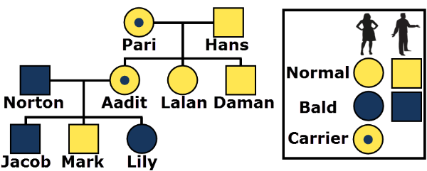
Here is the Maheswaran pedigree.
The squares represent males and the circles represent females.
The colours represent the phenotypes of the individuals. A key indicates which phenotype the different colours represent. Carriers always have a dot in the centre of their symbol.
In this case, yellow represents an individual with a normal hairline and blue represents an individual with male pattern baldness.

Slide 15
This pedigree shows that the recessive allele for male pattern baldness has become more common in the family!
This is because Aadit, who is a carrier, married a man with male pattern baldness. Both of them are capable of passing on the recessive allele!

Slide 16
Let's test your ability to read pedigrees by asking some revision questions.
How many males and how many females have male pattern baldness in the second generation (Aadit's generation)?
How many in the youngest generation (Jacob's generation)?

Slide 17
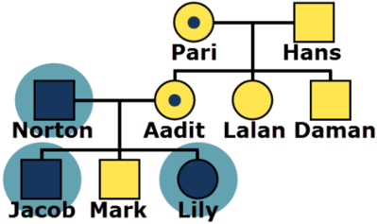
Answer:
In the second generation there is only one individual with male pattern baldness: Aadit's spouse Norton.
In the youngest generation there is one male (Jacob) and one female (Lily) with male pattern baldness.
The number of individuals with the disease has increased. There is even a female who is affected!

